Slide 1
Visual Bird Detection and Identification
Chunde Huang
Physics & Astronomy Department
August 07,2014

Slide 2
Content
Introduction to the project
Background Modeling method-ViBe
HOG+SVM for object detection
Future work(Convolutional Neural Networks)

Slide 3
Introduction to the project
To find flying birds in open sky.
Including two sub projects:
Using stationary camera to flying objects (ViBe)
Classifying method used for moving camera(SVM+HOG)

Slide 4
Introduction to the project

Slide 5
Background Modeling method
Background modeling methods are used to extract foreground objects from background that varies slowly with time or with the value of each pixel conforms to a certain distribution model.
For instance:
Sky with moving clouds
Super market indoor scene with moving lifts or flashing lights
City with lighting change
…

Slide 6
Background Modeling method
Foreground Objects are those not belong to background
Such as moving cars on streets
peoples insides a building
flying birds in the sky

Slide 7
Background Modeling method
There are many background modeling method, such as GMM, codebook etc
Here I picked ViBe method which is one of the best implementation
ViBe is very fast, and is patented
ViBe is easy to implement(in C++ or any other languages)
ViBe can be transplanted to imbed system
ViBe is more accurate(Better than GMM, codebook in general)
A POWERFUL RANDOM TECHNIQUE TO ESTIMATE THE BACKGROUND IN VIDEO SEQUENCES
By: Olivier Barnich and Marc Van Droogenbroeck

Slide 8
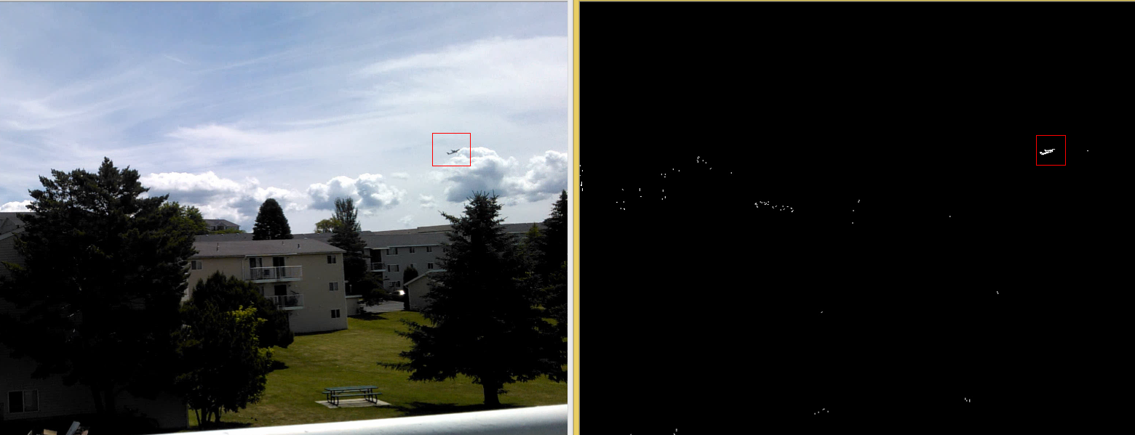
Background Modeling method

Slide 9
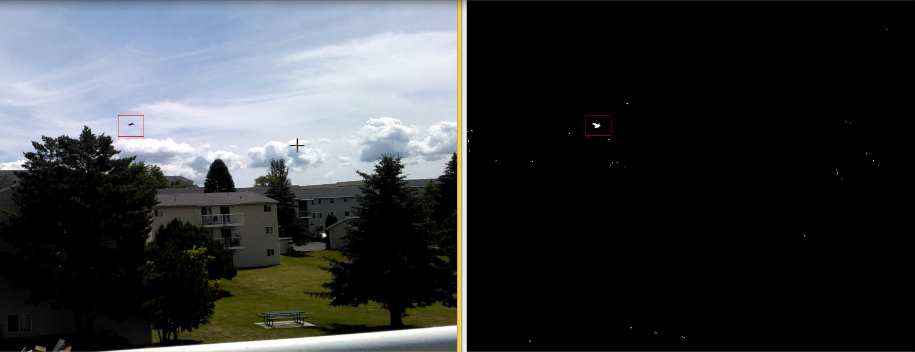
Background Modeling method

Slide 10
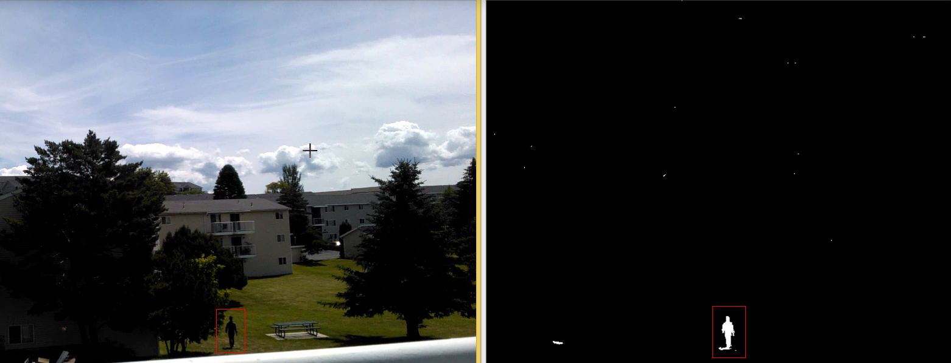
Background Modeling method

Slide 11
Background Modeling method
Some more testing results please watch the following videos on YouTube:
https://www.youtube.com/watch?v=lQUcZwmnGnI (An implementation of ViBe Background Model )
https://www.youtube.com/watch?v=uzY76q0mrh4 (Vibe Background Model on Downtown Traffic )

Slide 12
SVM+HOG for object detection
HOG(Histogram of oriented gradients) feature is very good for object profile representation. The essential thought behind the Histogram of Oriented Gradient descriptors is that local object appearance and shape within an image can be described by the distribution of intensity gradients or edge directions.
There are many good application of HOG(Such as human and vehicle detections)
Dalal, Navneet, and Bill Triggs. "Histograms of oriented gradients for human detection." Computer Vision and Pattern Recognition, 2005. CVPR 2005. IEEE Computer Society Conference on. Vol. 1. IEEE, 2005.

Slide 13
SVM+HOG for object detection
SVM( support vector machine) is widely used classification and regression analysis.
Supervised learning models with associated learning algorithms that analyze data and recognize patterns
Suykens, Johan AK, and Joos Vandewalle. "Least squares support vector machine classifiers." Neural processing letters 9.3 (1999): 293-300.

Slide 14
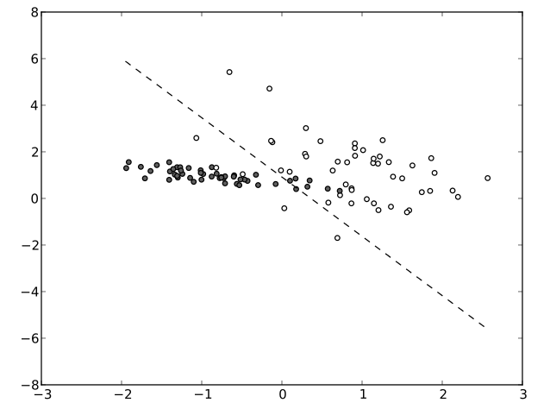
SVM+HOG for object detection
The dash line is the representation of support vector(in very high dimensional space)
that separates two different data sets

Slide 15
SVM+HOG for object detection
SVM+HOG is a very powerful scheme for object detection.
They can be used in moving cameras, while background modeling methods are only be used in fixed cameras.
There are many implementations of SVM available(OpenCV, SVMlib, lightSVM…).
HOG can be found in OpenCV.
Using some techniques(such as integral image) to improve the speed.

Slide 16
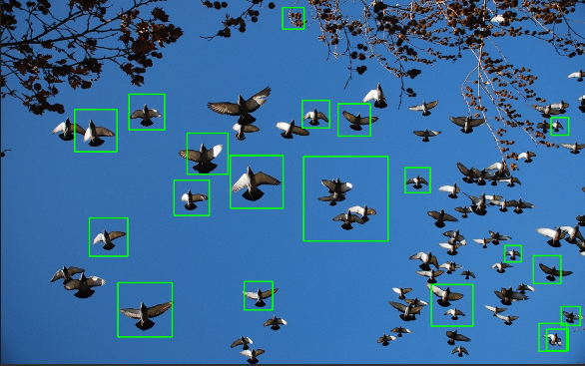
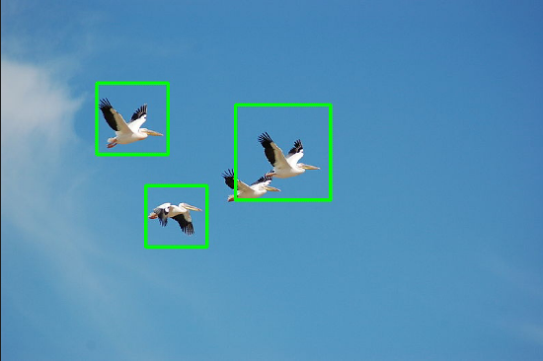
SVM+HOG for object detection
Current experimental result:

Slide 17
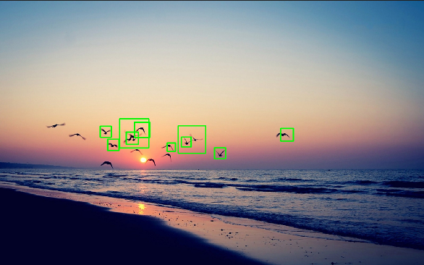
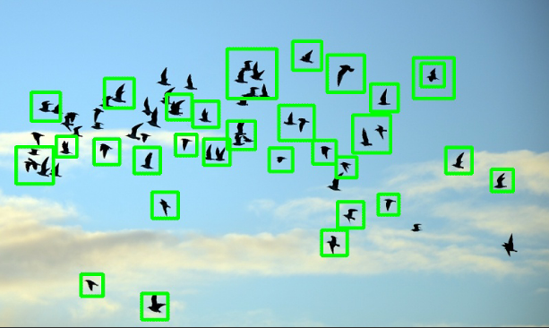
SVM+HOG for object detection
Current experimental result:

Slide 18
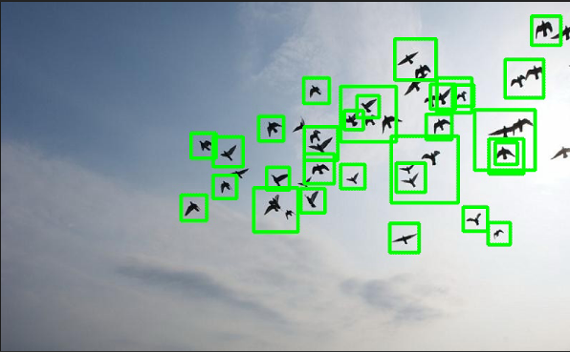
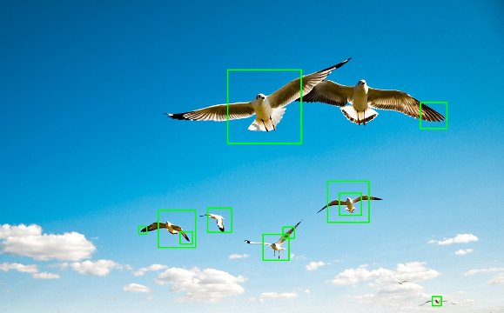
SVM+HOG for object detection
Current experimental result:

Slide 19
SVM+HOG for object detection
Training dataset contains around 1000 positive images(bird) and over 50,000 negative images(background).
It takes couples of minutes to several tens of minutes to get SVM converged.
A typical good dataset may need to have positive images up to 100,000. There is lots of work to do in the future to improve the detecting precision, to incorporate some enhanced techniques(such as object location prediction using past data) are also of great importance.

Slide 20
SVM+HOG for object detection
For those who are not familiar with computer vision, to fully understand the source code of HOG(OpenCV) is good way to learn about how to use it properly.
To develop analysis tools that can help visualize the data is vitally important.
Read papers on HOG, SVM.

Slide 21
Future work(Convolutional Neural Networks)
CNN feature is one of the latest achievement for computer vision which can used for fine grained detection and recognition. I wish to conduct such research in the future, which can be applied to our project.
http://arxiv.org/pdf/1403.6382v3.pdf
http://arxiv.org/pdf/1312.6229v4.pdf
http://arxiv.org/pdf/1310.1531.pdf
http://papers.nips.cc/paper/4824-imagenet-classification-with-deep-convolutional-neural-networks.pdf
http://caffe.berkeleyvision.org/

Slide 22
Thanks

